Slide 1
Intro to Sequence Analysis
Elizabeth Bartom, PhD
Department of Biochemistry and Molecular Genetics
Northwestern University
ebartom@northwestern.edu
Notes:
Add discussion of data flow and storage in a Northwestern University

Slide 2
Outline
Studying the Cell with Sequence
Overview of RNAseq Analysis
RNA-seq Pipeline Details
Hands-on with RNAseq

Slide 3
Outline
Studying the Cell with Sequence
Overview of RNAseq Analysis
RNA-seq Pipeline Details
Hands-on with RNAseq

Slide 4


Slide 5
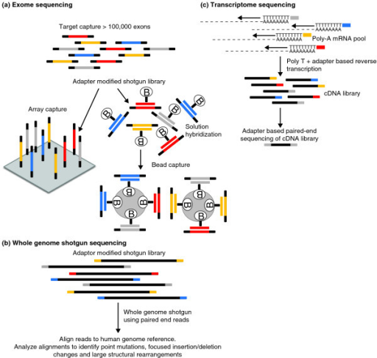
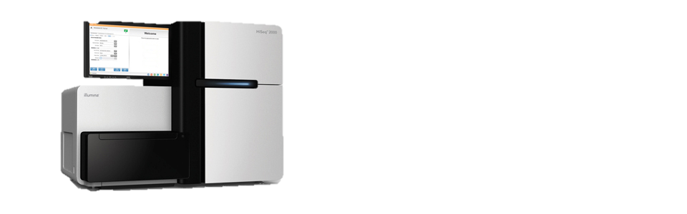
Whole Genome Sequencing

Slide 6
Capture (Exome) Sequencing

Slide 7
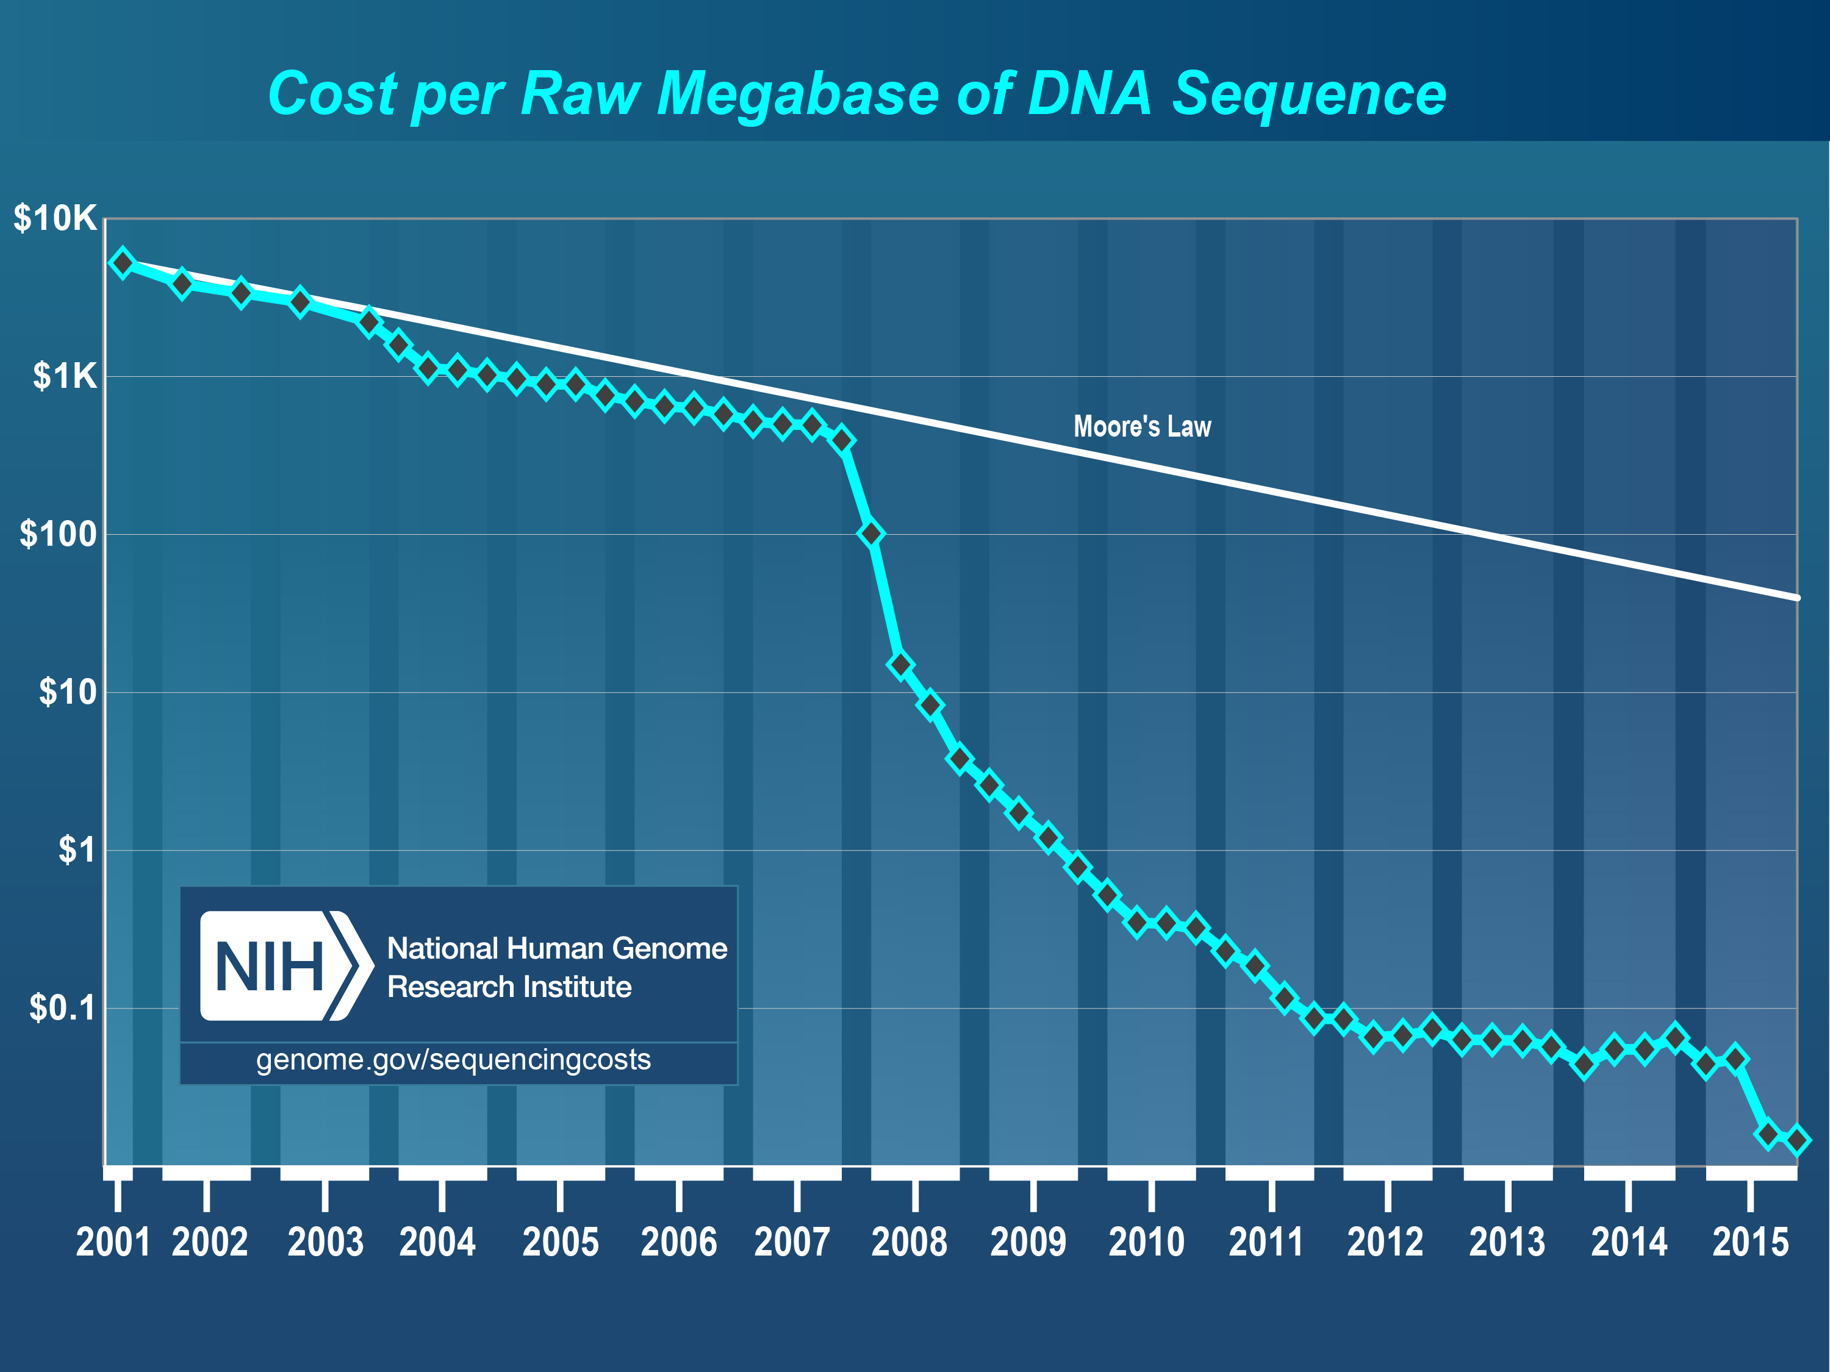
Moore’s Law
Human Genome Project = $2.7 billion
Notes:
Moore’s law – processing power doubles every two years

Slide 8
Moore’s Law
Exome
ChIP-seq
RNA-seq
Human Genome Project = $2.7 billion
Notes:
Moore’s law – processing power doubles every two years

Slide 9
RNA sequencing
TTTTTTTTT
AAAAAAAAA
TTTTTTTTT
AAAAAAAAA

Slide 10
ChIP-Seq
Chromatin ImmunoPrecipitation with Sequencing

Slide 11
ChIP-Seq
Chromatin ImmunoPrecipitation with Sequencing

Slide 12
ChIP-Seq
Chromatin ImmunoPrecipitation with Sequencing

Slide 13
ChIP-Seq
Chromatin ImmunoPrecipitation with Sequencing

Slide 14
ChIP-Seq
Chromatin ImmunoPrecipitation with Sequencing

Slide 15
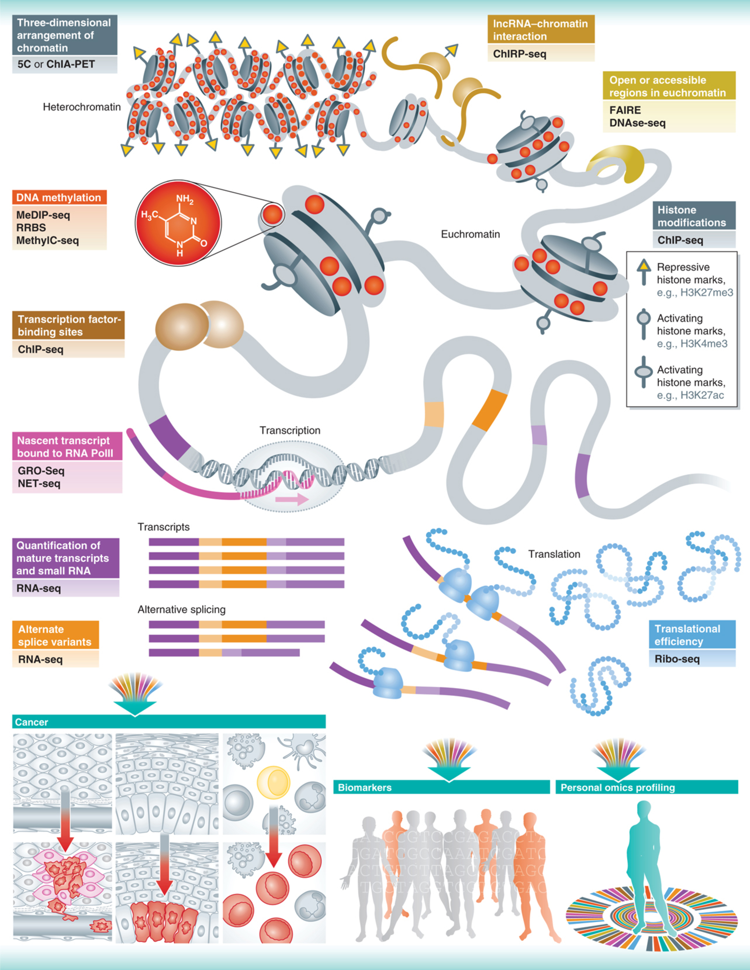
Heterochromatin
Euchromatin
Transcription Initiation
Transcripts
Translation
Alternative Splicing
Soon et al., 2013

Slide 16
Heterochromatin
Euchromatin
Transcription Initiation
Transcripts
Translation
Alternative Splicing
Soon et al., 2013
Soon et al., 2013

Slide 17
Heterochromatin
Euchromatin
Transcription Initiation
Transcripts
Translation
Alternative Splicing
Soon et al., 2013
Soon et al., 2013

Slide 18

Heterochromatin
Euchromatin
Transcription Initiation
Transcripts
Translation
Alternative Splicing
Soon et al., 2013
Soon et al., 2013

Slide 19
Heterochromatin
Euchromatin
Transcription Initiation
Transcripts
Translation
Alternative Splicing
Soon et al., 2013
Soon et al., 2013

Slide 20
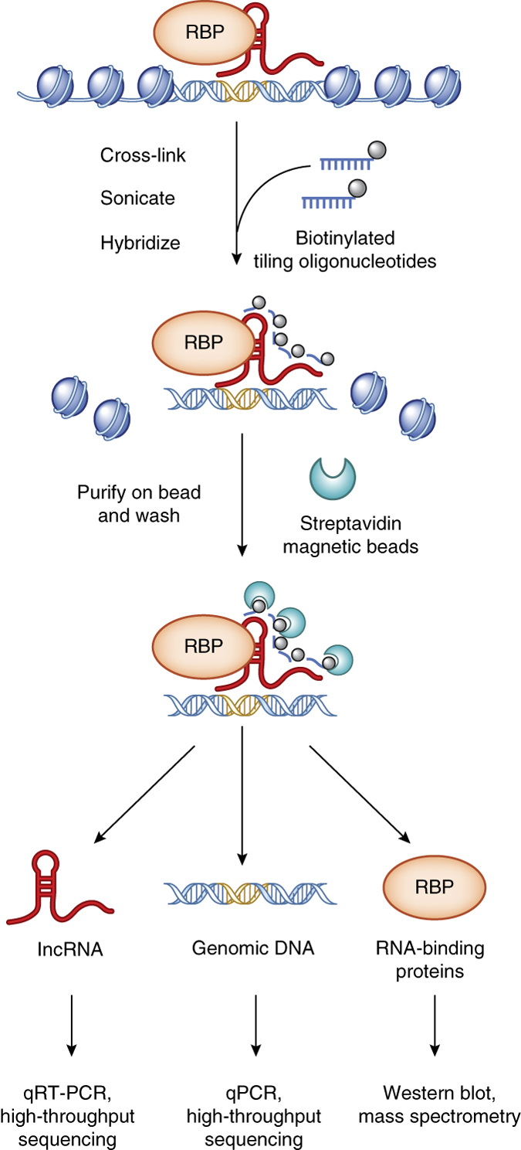
ChIRP-seq Pull down lncRNA to find bound DNA

Slide 21
Heterochromatin
Euchromatin
Transcription Initiation
Transcripts
Translation
Alternative Splicing
Soon et al., 2013
Soon et al., 2013

Slide 22
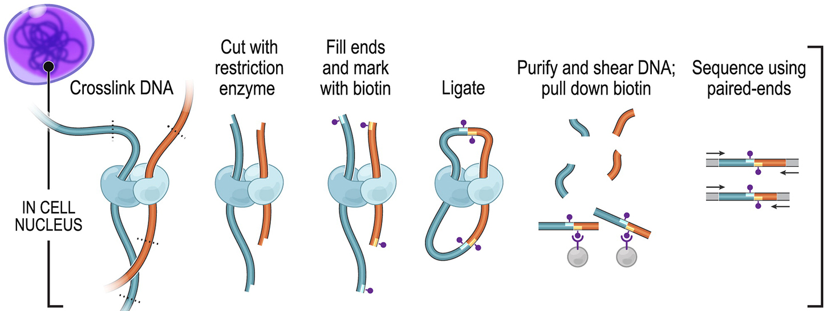
Chromatin Conformation Capture (3C, 4C, Hi-C, etc)

Slide 23
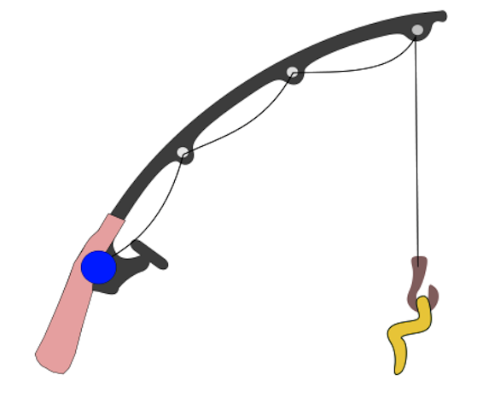


Common themes
Pulldown – Streptavidin, Antibody
Hook – Cross-linking (UV, formaldehyde)
Fragmentation (Digestion, sonication)
Bait – Protein, Oligo, Epitope

Slide 24
Outline
Studying the Cell with Sequence
Overview of RNAseq Analysis
RNA-seq Pipeline Details
Hands-on with RNAseq

Slide 25
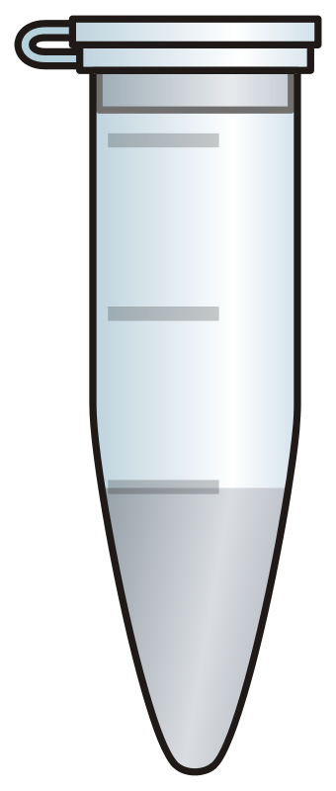
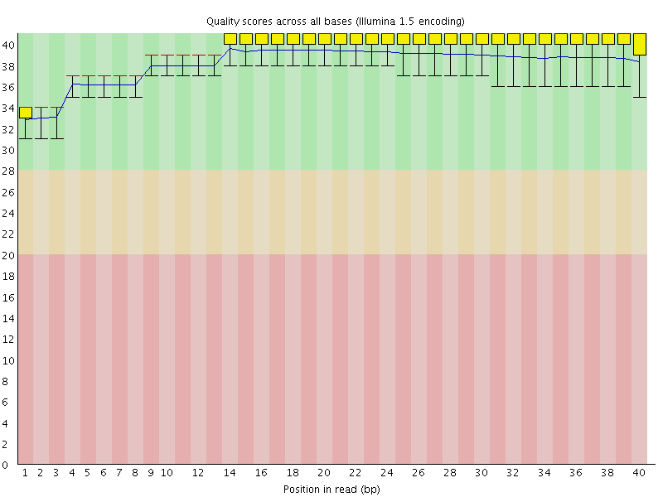
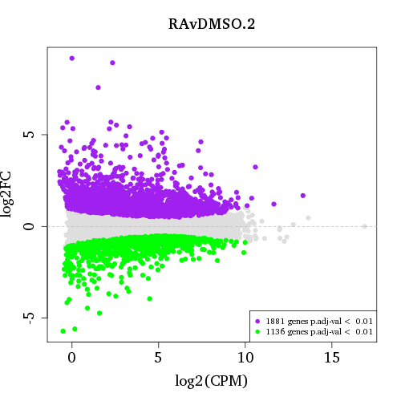
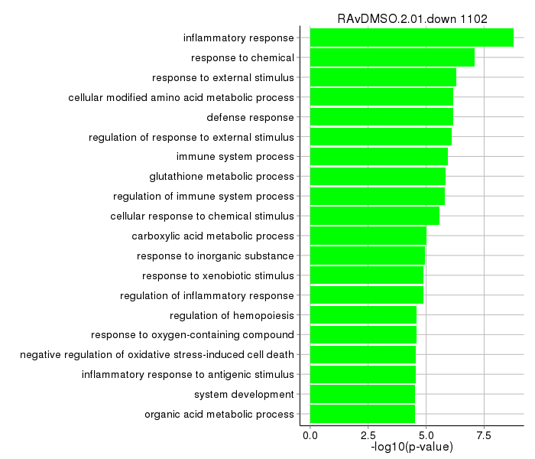
RNA sample1
RNA sample2
RNA-seq
Check Sequence Quality
Align to Reference Genome
Estimate Gene Expression
Find Differentially Expressed Genes and Make Plots

Slide 26
Extracted RNA Library
DNA fragment length
Read length
Paired end or Single
@ERR030881.21417929/1
CATGACCCTGAGTTGTCAGACAAAGTTGCCCCTGCAGAGGTCAGCTGCCC
+
HGHHHHHHHHHHHHHHHHHHHHHHHHHHHHHHHHHHHHHHHHHHHHHHHH
@ERR030881.59349201/1
CATGACCCTGAGTTGTCAGACAAAGTTGCCCCTGCAGAGGTCAGCTGCCC
+
HEGHHHHHFH5'45544554HHHHHHEEHHEFEFC5*44435555EEEGG
@ERR030881.63660328/1
CATGACCCTGAGTNGTCAGACAAAGTTGCCCCTGCAGAGGTCAGCTGCCC
+
HHHHHHHHHHGGG#GFFFDFHHHHHHHIHHHHHHHHHHHHIHHHHHHHHH
@ERR030881.65131462/1
CGGTTGTCCTCAGNGGCTGCCTCACACCAGTATGACCCGGAGTCATCTTC
+
HHHHHHHHHHFFF#F@==>8FAFC>44445>A@AA9DF:I##########
@ERR030881.40687283/1
TCACAGTCCAAGAACTGTTTCCAGCGCCAATTCTCAGAGCTGTACCCTCA
+
HHHHHHHHHHHHHHHHHHHHHHHHHHHHHHHHHHHHHHHHHHHHHIHHHH
@ERR030881.9914386/1
CTCAGAGCTGTACCCTCAGCTGAACCCCAAGCAGGAAGCCCCATGACCTT
+
HGHHHHHHHHHHHHHHHHHHHHHHHHHHGHHHHHHHHHHHHHHHHHHH=H
@ERR030881.45973010/1
GTTTCCAGCGCCAATTCTCAGAGCTGTACCCTCAGCTGAACCCCAAGCAG
+
HGHHHHHHHHHHHHHHHHHHHHHHHHHHHHHHHHHHHHHHHHHHHHHHHH
@ERR030881.4677847/1
ATGAACTGTTTCCAGCGCCAATTCTCAGAGCTGTACCCTCAGCTGAACCC
+
HEHHHHHHHHHHHHHHHHHHHHHHHHHHHHHHHHHHHHHHHHHHHHHHHH
@ERR030881.5235358/1
ATGAACTGTTTCCAGCGCCAATTCTCAGAGCTGTACCCTCAGCTGAACCC
+
HGHHHHHHHHHHHHHGHHHHHHHHHHHHHHHHHHHHHHHHGHHHHHHHHH
@ERR030881.5847314/1
ATGAACTGTTTCCAGCGCCAATTCTCAGAGCTGTACCCTCAGCTGAACCC
+
GDGGGHHHIHHHHHHHHHHHHHHHHHHHIHHHHHHHHHHHHHHHHHHHHE
@ERR030881.10033536/1
ATGAACTGTTTCCAGCGCCAATTCTCAGAGCTGTACCCTCAGCTGAACCC
+
HDHHHHHHHHHHHHHHHHHHHHHHHHHHDHHHHHHHHHHHHHHHHHHHHH
@ERR030881.20926444/1
TGGGGGCTCTGTTTCCAAACTTGGTTGTCCTCAGTGGCTGCCTCACAACA
+
55544=<>=>HHHIHIHHHHHGDDHHHHHH?AADAHHHHH##########
@ERR030881.23180831/1
GAACTGTTTCCAGCGCCAATTCTCAGAGCTGTACCCTCAGCTGAACCCCA
+
HHHHHHHHHHHHHHHHHHHHHHHHHHHHHHHHHHHHHHHHHHHHHHHHHH
@ERR030881.32994556/1
ATGAACTGTTTCCAGCGCCAATTCTCAGAGCTGTACCCTCAGCTGAACCC
+
GDFFFHGEHGHHGIGFFHGHIHHHHGHHHHGHHHHHHHHGHHGHHHEHHH
@ERR030881.47164969/1
TGGGGGCTCTGTTTCCAAACTTGGTTGTCCTCAGTGGCTGCCTCACACCA
+
HHHHHHHHHHHHHHHHHHHHHHHHHHHHHHHHHHHHHHHHBF@DBGFGG5
@ERR030881.21417929/2
CCTCACACCAGTATGACCCGGAGTGATCTTCTGAAGCTGTGGGGATCTGG
+
HHHHHHHHHHHHHHHHHHHHHHHDHHHHHHHHHHHHHHHHHHHHHHHEHH
@ERR030881.59349201/2
CCTCACACCAGTATGACCCGGAGGGATCTTCTGAAGCTGGGGGGATCTGG
+
HHADHGFEEB5554445544524+(45544==53?1555,2411435445
@ERR030881.63660328/2
CCTCACACCAGTATGACCCGGAGTGATCTTCTGAAGCTGTGGGGATCTGG
+
HHHHHHHHHHHHHHHHHHHHHIHIHHHHHHHHHHHHHHHHHHHHHHHHHH
@ERR030881.65131462/2
CCAAGAACTGTTTGCAGCGCCAATTCTCAGAGCTGTACCCTCAGCTGAAC
+
HHHHHHHHHHHHH=HHHHHHHHHHHHHHHHHHHHHHHHHHHHHGHHHHHH
@ERR030881.40687283/2
CAAACTTGGTTGTCCTCAGTGGCTGGCTCACACCAGTATGACCCGGAGTG
+
HHHHHHHHHHHHHHHHHHHHHHHHH45563>3=@################
@ERR030881.9914386/2
GGGGGCTCTGTTTCCAAACTTGGTTGTCCTCAGTGGCTGGCTCACACCAG
+
HHHHHHHHHHHHHHHHHHHHHHHHHHHHHHHHHHHHHHH;54464FFF;B
@ERR030881.45973010/2
GGGGGCTCTGTTTCCAAACTTGGTTGTCCTCAGTGGCTGCCTCACACCCG
+
HHHHHHHHHHHHHHHHHHHHHHHHHHHHHHHHHHHHHHH:5-434FDF1B
@ERR030881.4677847/2
TGGGGGCTCTGTTTCCAAACTTGGTTGTCCTCAGTGGCTGCCTCACACCA
+
HHHHHHHHHHHHHHHHHHHHHHHHHHHHHHHHHIHHHHEI35434HHHHB
@ERR030881.5235358/2
TGGGGGCTCTGTTTCCAAACTTGGTTGTCCTCAGTGGCTGCCCCCCACCA
+
HIHHHHHHHHHHEHHHIHHHHHHHHHHHHHHHHHHHIHHG##########
@ERR030881.5847314/2
TGGGGGCTCTGTTTCCAAACTTGGTTGTCCTCAGTGGCTGCCTCACCCCA
+
HHHHHHHHHHHHHHHHHHHHHHHHHHEHHHHHIHHHHHG@##########
@ERR030881.10033536/2
TGGGGGCTCTGTTTCCAAACTTGGTTGTCCTCAGTGGCTGCCTCACCCCA
+
HHHGHHHHHHHHHHHHHHHHHHHHHHHHHGHHGGEHHHHH55044D:@C:
@ERR030881.20926444/2
GAACTGTTTCCAGCGCCAATTCTCAGAGCTGTACCCTCAGCTGAACCCCA
+
HGDGHHHHHIHHHIHHHGGHGGHHHHHHHFHHHHGHHHHIHIHHHHFEH@
@ERR030881.23180831/2
TGGGGGCTCTGTTTCCAAACTTGGTTGTCCTCAGTGGCTGCCTCACACCC
+
HHHHHHHHHHHHHHHHHHHHHHHHHHHHHHHHHHHFHHHH02225AADA4
@ERR030881.32994556/2
TGGGGGCTCTGTTTCCAAACTTGGTTGTCCTCAGTGGCTGCCTCCAACCA
+
HHEHHFFHHHHGHHGHHHHHH@IHHHHHHHFFHHH=9=<@##########
@ERR030881.47164969/2
GAACTGTTTCCAGCGCCAATTCTCAGAGCTGTACCCTCAGCTGAACCCCA
+
HHHHHHHHHHHHHHHHHHHHHHHHHHHHHHHHHHHHHHHHHHHHHHHHHH

Slide 27
FastQ Format
@ERR030881.21417929/1
CATGACCCTGAGTTGTCAGACAAAGTTGCCCCTGCAGAGGTCAGCTGCCC
+
HGHHHHHHHHHHHHHHHHHHHHHHHHHHHHHHHHHHHHHHHHHHHHHHHH
@ERR030881.59349201/1
CATGACCCTGAGTTGTCAGACAAAGTTGCCCCTGCAGAGGTCAGCTGCCC
+
HEGHHHHHFH5'45544554HHHHHHEEHHEFEFC5*44435555EEEGG
@ERR030881.63660328/1
CATGACCCTGAGTNGTCAGACAAAGTTGCCCCTGCAGAGGTCAGCTGCCC
+
HHHHHHHHHHGGG#GFFFDFHHHHHHHIHHHHHHHHHHHHIHHHHHHHHH
@ERR030881.65131462/1
CGGTTGTCCTCAGNGGCTGCCTCACACCAGTATGACCCGGAGTCATCTTC
+
HHHHHHHHHHFFF#F@==>8FAFC>44445>A@AA9DF:I##########
@ERR030881.40687283/1
TCACAGTCCAAGAACTGTTTCCAGCGCCAATTCTCAGAGCTGTACCCTCA
+
HHHHHHHHHHHHHHHHHHHHHHHHHHHHHHHHHHHHHHHHHHHHHIHHHH
@ERR030881.9914386/1
CTCAGAGCTGTACCCTCAGCTGAACCCCAAGCAGGAAGCCCCATGACCTT
+
HGHHHHHHHHHHHHHHHHHHHHHHHHHHGHHHHHHHHHHHHHHHHHHH=H
@ERR030881.21417929/2
CCTCACACCAGTATGACCCGGAGTGATCTTCTGAAGCTGTGGGGATCTGG
+
HHHHHHHHHHHHHHHHHHHHHHHDHHHHHHHHHHHHHHHHHHHHHHHEHH
@ERR030881.59349201/2
CCTCACACCAGTATGACCCGGAGGGATCTTCTGAAGCTGGGGGGATCTGG
+
HHADHGFEEB5554445544524+(45544==53?1555,2411435445
@ERR030881.63660328/2
CCTCACACCAGTATGACCCGGAGTGATCTTCTGAAGCTGTGGGGATCTGG
+
HHHHHHHHHHHHHHHHHHHHHIHIHHHHHHHHHHHHHHHHHHHHHHHHHH
@ERR030881.65131462/2
CCAAGAACTGTTTGCAGCGCCAATTCTCAGAGCTGTACCCTCAGCTGAAC
+
HHHHHHHHHHHHH=HHHHHHHHHHHHHHHHHHHHHHHHHHHHHGHHHHHH
@ERR030881.40687283/2
CAAACTTGGTTGTCCTCAGTGGCTGGCTCACACCAGTATGACCCGGAGTG
+
HHHHHHHHHHHHHHHHHHHHHHHHH45563>3=@################
@ERR030881.9914386/2
GGGGGCTCTGTTTCCAAACTTGGTTGTCCTCAGTGGCTGGCTCACACCAG
+
HHHHHHHHHHHHHHHHHHHHHHHHHHHHHHHHHHHHHHH;54464FFF;B
@ERR030881.65131462/1
CGGTTGTCCTCAGNGGCTGCCTCACACCAGTATGACCCGGAGTCATCTTC
+
HHHHHHHHHHFFF#F@==>8FAFC>44445>A@AA9DF:I##########

Slide 28
Quality Scores
@ERR030881.65131462/1
CGGTTGTCCTCAGNGGCTGCCTCACACCAGTATGACCCGGAGTCATCTTC
+ERR030881.65131462/1
HHHHHHHHHHFFF#F@==>8FAFC>44445>A@AA9DF:I##########
||||||||||||||||||||||||||||||||||||||||||
!"#$%&'()*+,-./0123456789:;<=>?@ABCDEFGHIJKLMNOPQRSTUVWXYZ[\]^_`abcdefghijklm
| | | | |
0 10 20 30 41
Illumina 1.8+ (Phred+33)

Slide 29
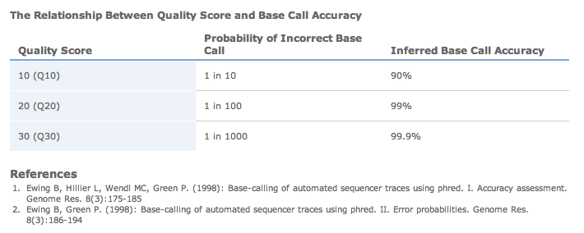
@ERR030881.65131462/1
CGGTTGTCCTCAGNGGCTGCCTCACACCAGTATGACCCGGAGTCATCTTC
+ERR030881.65131462/1
HHHHHHHHHHFFF#F@==>8FAFC>44445>A@AA9DF:I##########
39 = 99.99%
19 = 98.74%
2 = low quality 3’ end

Slide 30
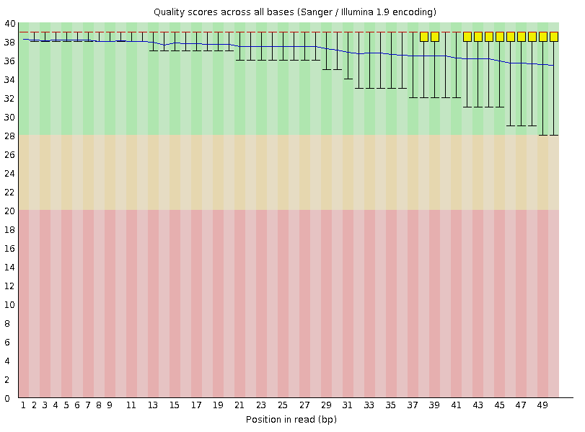
Quality Score Distribution

Slide 31
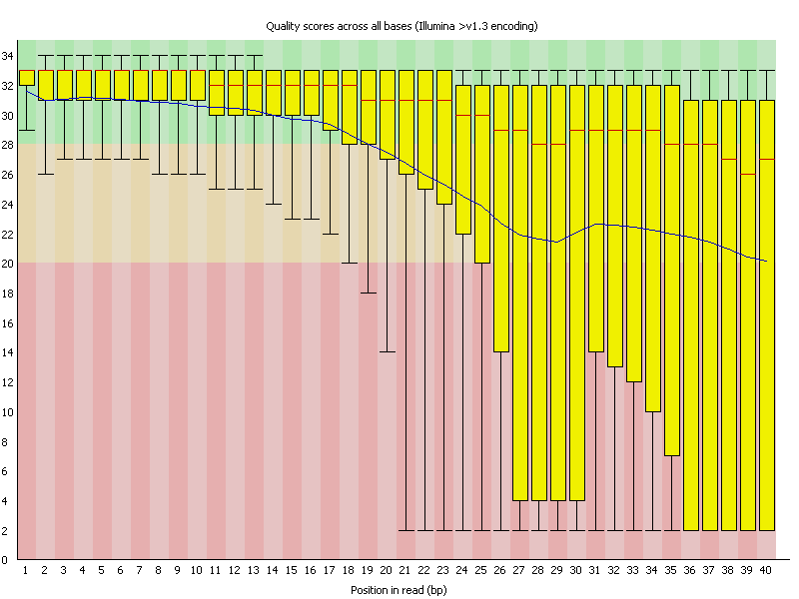
Quality Score Distribution

Slide 32
Map Raw Reads To Reference
Raw Reads (x 10,000,000 or so)
Considerations: Speed? Accuracy? Spliced Reads?

Slide 33
Map Raw Reads To Reference
Bowtie and Tophat
http://tophat.cbcb.umd.edu/

Slide 34
Mapping Quality
Based on
Read Quality
Uniqueness of mapping
Mismatches
Indels

Slide 35
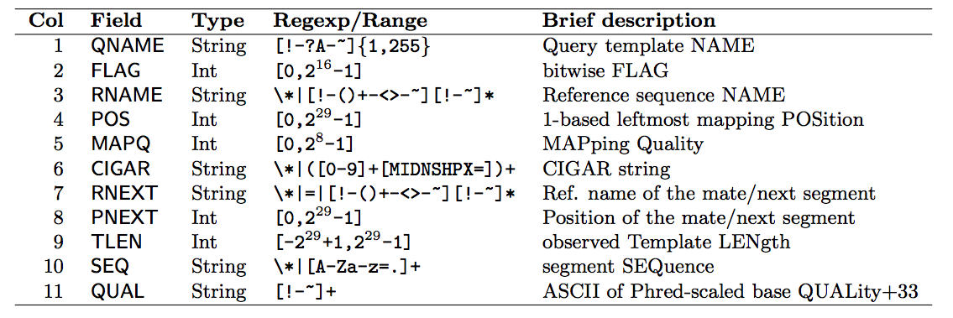
Bamfiles (Samfiles)
NS500577:15:H3MKLBGXX:2:11311:19842:4617 272 chr1 3038025 0 4M1I45M * 0 0 CCGCGGGGGGCCACCTTGATTCTGGAACTCCGCAGCAGGCAGTCTGCAGG FFFFFFFF<FFFFFF.FFFFFFFFFFFFFFFFFAFFFFFFFFFFFAAAAA AS:i:-13 XN:i:0 XM:i:1 XO:i:1 XG:i:1 NM:i:2 MD:Z:3T45 YT:Z:UU NH:i:5 CC:Z:chr11 CP:i:63805304 HI:i:0

Slide 36
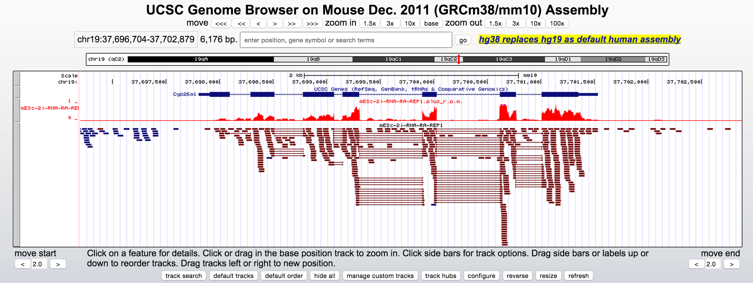
Visualizing the data

Slide 37
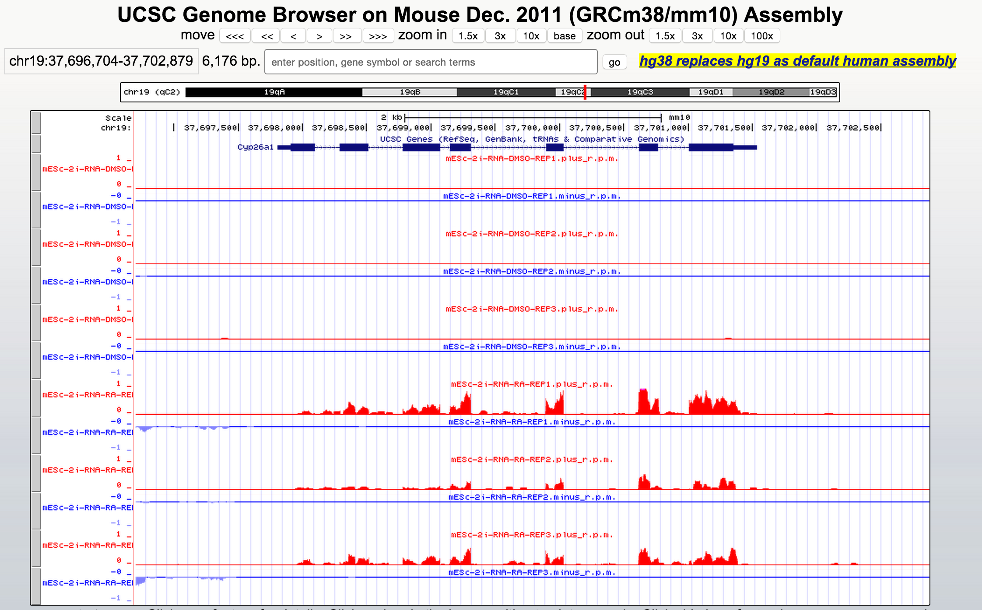

Slide 38
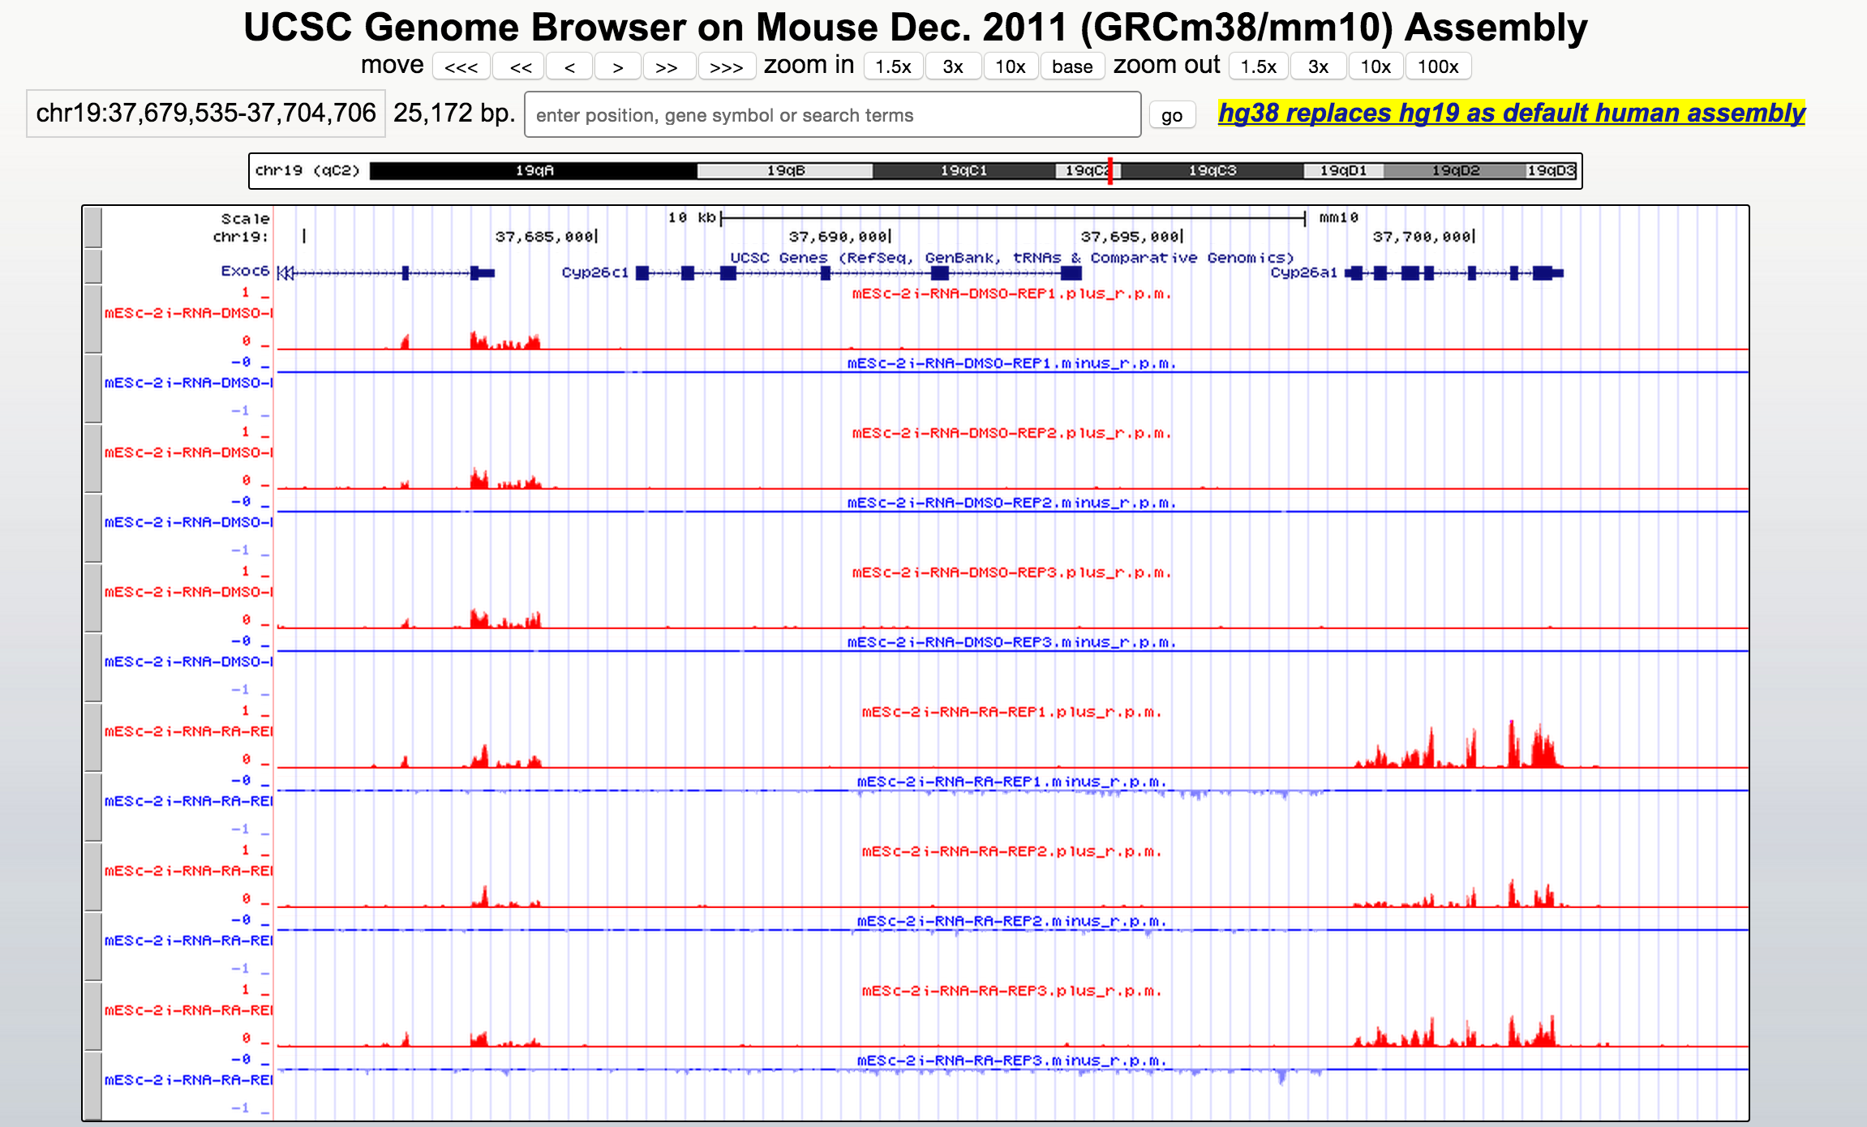

Slide 39
Assign Expression Values to Transcripts

Slide 40
Assign Expression Values to Transcripts
40 reads
40 reads

Slide 41
Which reads are informative about a gene?
% informative reads
100
gRanges
80
+
+
htseq
60
+
rsem
20
+

Slide 42
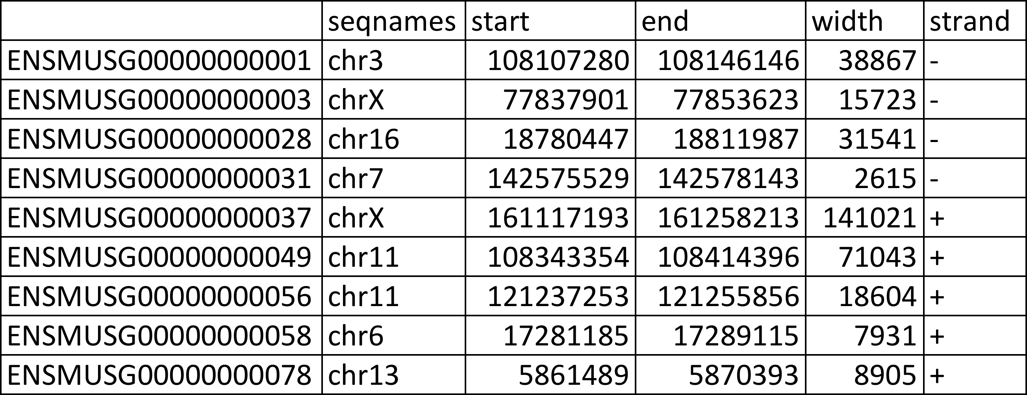
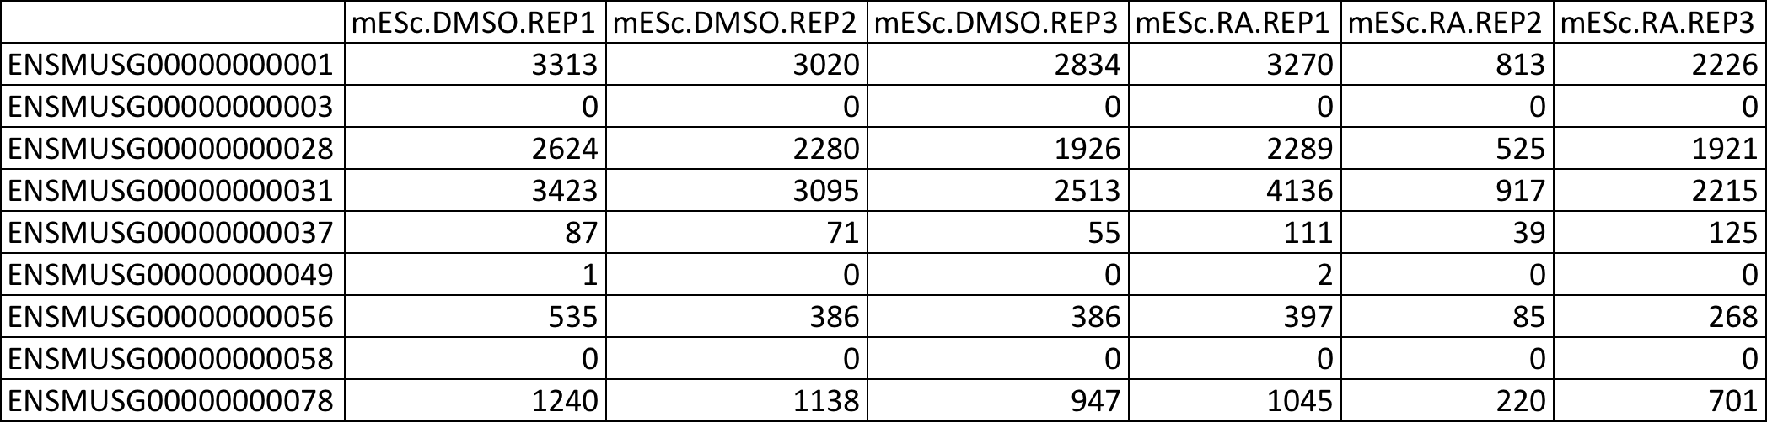
Counts Table

Slide 43
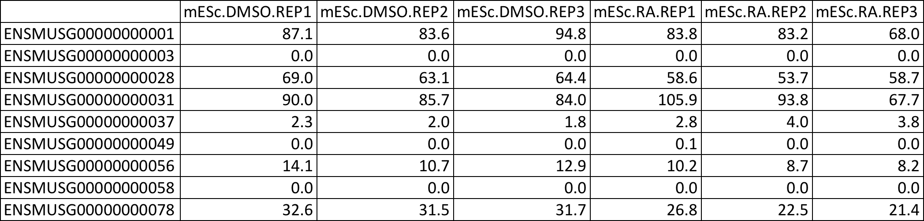
From Counts to RPM

Slide 44
MDS Plot

Slide 45
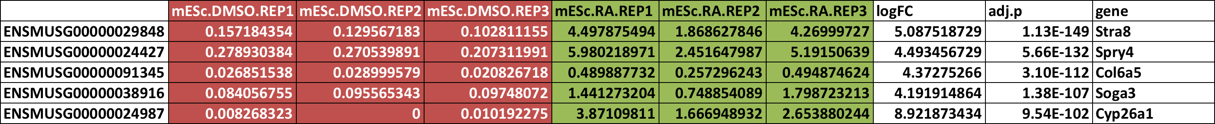
Differentially Expressed?
Comparisons Table

Slide 46
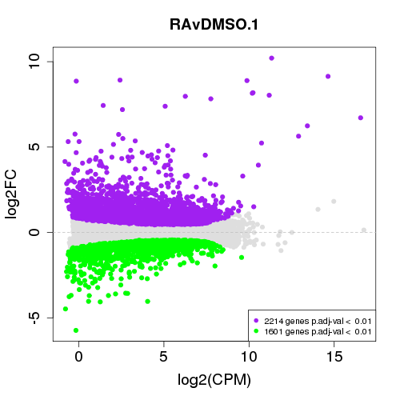
MA plot

Slide 47
Expression Heatmap

Slide 48
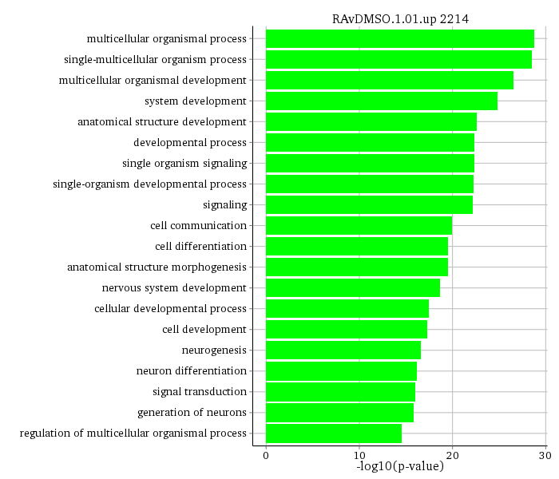
GO Analysis

Slide 49
RNA sample1
RNA sample2
RNA-seq
Check Sequence Quality
Align to Reference Genome
Estimate Gene Expression
Find Differentially Expressed Genes and Make Plots

Slide 50
Outline
Studying the Cell with Sequence
Overview of RNAseq Analysis
RNA-seq Pipeline Details
Hands-on with RNAseq

Slide 51
buildPipelineScripts.pl (-t RNA)
Raw Sequencing Data
runBcl2fastq
- de-multiplex samples - generate fastq files
Fastq files
runAlign
- trim Fastq sequences
- Check FastQ Quality
- Align with Tophat
- Build tracks for Genome Browser
BAM files
runEdgeR
- make counts table
- create MDS plot
- compare sample expression with EdgeR
- for each comparison:
- Make MA plots
- Make Heatmaps
- Run GO analysis

Slide 52
Usage: buildPipelineScripts.pl
-o <outputDirectory>
-bs <baseSpaceDirectory>
-f <fastqDirectory>
-bam <bamDirectory>
-c <comparisons.csv file>
-4C <4C description file>
-chip <ChIP Description file>
-p <numProcessors>
-g <assembly/genome>
-t <RNA|chipseq|4C>
-account <accountName>
-node <nodeName(eg qnode4144)>
-scientist <initials>
-buildBcl2fq <1|0>
-runBcl2fq <1|0>
-runTrim <1|0>
-buildAlign <1|0>
-runAlign <1|0>
-makeTracks <1|0>
-uploadASHtracks <1|0>
-buildEdgeR <1|0>
-runEdgeR <1|0>
-buildPeakCaller <1|0>
-runPeakCaller <1|0>
-buildDiffPeaks <1|0>
-runDiffPeaks <1|0>
-build4C <1|0>
-run4C <1|0>

Slide 53
Usage: buildPipelineScripts.pl
-o <outputDirectory>
-bs <baseSpaceDirectory>
-f <fastqDirectory>
-bam <bamDirectory>
-c <comparisons.csv file>
-4C <4C description file>
-chip <ChIP Description file>
-p <numProcessors>
-g <assembly/genome>
-t <RNA|chipseq|4C>
-account <accountName>
-node <nodeName(eg qnode4144)>
-scientist <initials>
-buildBcl2fq <1|0>
-runBcl2fq <1|0>
-runTrim <1|0>
-buildAlign <1|0>
-runAlign <1|0>
-makeTracks <1|0>
-uploadASHtracks <1|0>
-buildEdgeR <1|0>
-runEdgeR <1|0>
-buildPeakCaller <1|0>
-runPeakCaller <1|0>
-buildDiffPeaks <1|0>
-runDiffPeaks <1|0>
-build4C <1|0>
-run4C <1|0>
Essential Arguments

Slide 54
Usage: buildPipelineScripts.pl
-o <outputDirectory>
-bs <baseSpaceDirectory>
-f <fastqDirectory>
-bam <bamDirectory>
-c <comparisons.csv file>
-4C <4C description file>
-chip <ChIP Description file>
-p <numProcessors>
-g <assembly/genome>
-t <RNA|chipseq|4C>
-account <accountName>
-node <nodeName(eg qnode4144)>
-scientist <initials>
-buildBcl2fq <1|0>
-runBcl2fq <1|0>
-runTrim <1|0>
-buildAlign <1|0>
-runAlign <1|0>
-makeTracks <1|0>
-uploadASHtracks <1|0>
-buildEdgeR <1|0>
-runEdgeR <1|0>
-buildPeakCaller <1|0>
-runPeakCaller <1|0>
-buildDiffPeaks <1|0>
-runDiffPeaks <1|0>
-build4C <1|0>
-run4C <1|0>
Essential Arguments
Determine samples from Base Space Directory & Sample Sheet

Slide 55
Usage: buildPipelineScripts.pl
-o <outputDirectory>
-bs <baseSpaceDirectory>
-f <fastqDirectory>
-bam <bamDirectory>
-c <comparisons.csv file>
-4C <4C description file>
-chip <ChIP Description file>
-p <numProcessors>
-g <assembly/genome>
-t <RNA|chipseq|4C>
-account <accountName>
-node <nodeName(eg qnode4144)>
-scientist <initials>
-buildBcl2fq <1|0>
-runBcl2fq <1|0>
-runTrim <1|0>
-buildAlign <1|0>
-runAlign <1|0>
-makeTracks <1|0>
-uploadASHtracks <1|0>
-buildEdgeR <1|0>
-runEdgeR <1|0>
-buildPeakCaller <1|0>
-runPeakCaller <1|0>
-buildDiffPeaks <1|0>
-runDiffPeaks <1|0>
-build4C <1|0>
-run4C <1|0>
Essential Arguments
Determine samples from Fastq Directory
Must specify assembly!

Slide 56
Usage: buildPipelineScripts.pl
-o <outputDirectory>
-bs <baseSpaceDirectory>
-f <fastqDirectory>
-bam <bamDirectory>
-c <comparisons.csv file>
-4C <4C description file>
-chip <ChIP Description file>
-p <numProcessors>
-g <assembly/genome>
-t <RNA|chipseq|4C>
-account <accountName>
-node <nodeName(eg qnode4144)>
-scientist <initials>
-buildBcl2fq <1|0>
-runBcl2fq <1|0>
-runTrim <1|0>
-buildAlign <1|0>
-runAlign <1|0>
-makeTracks <1|0>
-uploadASHtracks <1|0>
-buildEdgeR <1|0>
-runEdgeR <1|0>
-buildPeakCaller <1|0>
-runPeakCaller <1|0>
-buildDiffPeaks <1|0>
-runDiffPeaks <1|0>
-build4C <1|0>
-run4C <1|0>
Essential Arguments
Determine samples from BAM Directory
Must specify assembly!

Slide 57
Usage: buildPipelineScripts.pl
-o <outputDirectory>
-bs <baseSpaceDirectory>
-f <fastqDirectory>
-bam <bamDirectory>
-c <comparisons.csv file>
-4C <4C description file>
-chip <ChIP Description file>
-p <numProcessors>
-g <assembly/genome>
-t <RNA|chipseq|4C>
-account <accountName>
-node <nodeName(eg qnode4144)>
-scientist <initials>
-buildBcl2fq <1|0>
-runBcl2fq <1|0>
-runTrim <1|0>
-buildAlign <1|0>
-runAlign <1|0>
-makeTracks <1|0>
-uploadASHtracks <1|0>
-buildEdgeR <1|0>
-runEdgeR <1|0>
-buildPeakCaller <1|0>
-runPeakCaller <1|0>
-buildDiffPeaks <1|0>
-runDiffPeaks <1|0>
-build4C <1|0>
-run4C <1|0>
Essential Arguments
Determine samples from Base Space Directory & Sample Sheet
Choose steps in the analysis

Slide 58
/projects/p20742/tools/buildPipelineScripts.pl \
-t RNA \
-o /projects/w10001/${USER} \
-account w10001 \
-g mm10 \
-f /projects/w10001/testRNA.fastq \
-c /projects/w10001/testRNA.fastq/comparisons.csv \
-uploadASHtracks 0 \
-runAlign 1 \
-runEdgeR 1 \
>& buildPipelineScripts.rna.${USER}.log &

Slide 59
/projects/p20742/tools/buildPipelineScripts.pl \
-t RNA \
-o /projects/w10001/${USER} \
-account w10001 \
-g mm10 \
-f /projects/w10001/testRNA.fastq \
-c /projects/w10001/testRNA.fastq/comparisons.csv \
-uploadASHtracks 0 \
-runAlign 1 \
-runEdgeR 1 \
>& buildPipelineScripts.rna.${USER}.log &
Content of Comparisons File:

Slide 60
Outline
Studying the Cell with Sequence
Overview of RNAseq Analysis
RNA-seq Pipeline Details
Hands-on with RNAseq

Slide 61
ssh –Y yourNETID@quest.it.northwestern.edu
module load perl
cd /projects/w10001/
# Make a directory for your analysis.
mkdir /projects/w10001/${USER}
# Change to the directory you just made.
cd /projects/w10001/${USER}
# Build the pipeline scripts in that directory.
/projects/p20742/tools/buildPipelineScripts.pl \
-t RNA \
-o /projects/w10001/${USER} \
-account w10001 \
-g mm10 \
-f /projects/w10001/testRNA.fastq \
-c /projects/w10001/testRNA.fastq/comparisons.csv \
-uploadASHtracks 0 \
-runAlign 1 \
-runEdgeR 1 \
>& buildPipelineScripts.rna.${USER}.log &
# Change back to original directory.
cd /projects/w10001/

Slide 62

Beyond this point lie dragons (or, at least, disordered slides)

Slide 63
To set up a new quest account for the pipeline:
#load R
module load R
# open R
R
# Set up R packages
source(“http://bioconductor.org/biocLite.R”)
biocLite(“BSgenome.Mmusculus.UCSC.mm10”)
biocLite("BSgenome.Mmusculus.UCSC.mm9")
biocLite("BSgenome.Hsapiens.UCSC.hg19")
biocLite("BSgenome.Hsapiens.UCSC.hg38”)
biocLite("BSgenome.Scerevisiae.UCSC.sacCer3”)
biocLite(“ChIPpeakAnno”)
biocLite(“topGO”)
# exit R
q()
Also, email me for access to /projects/p20742/

Slide 64
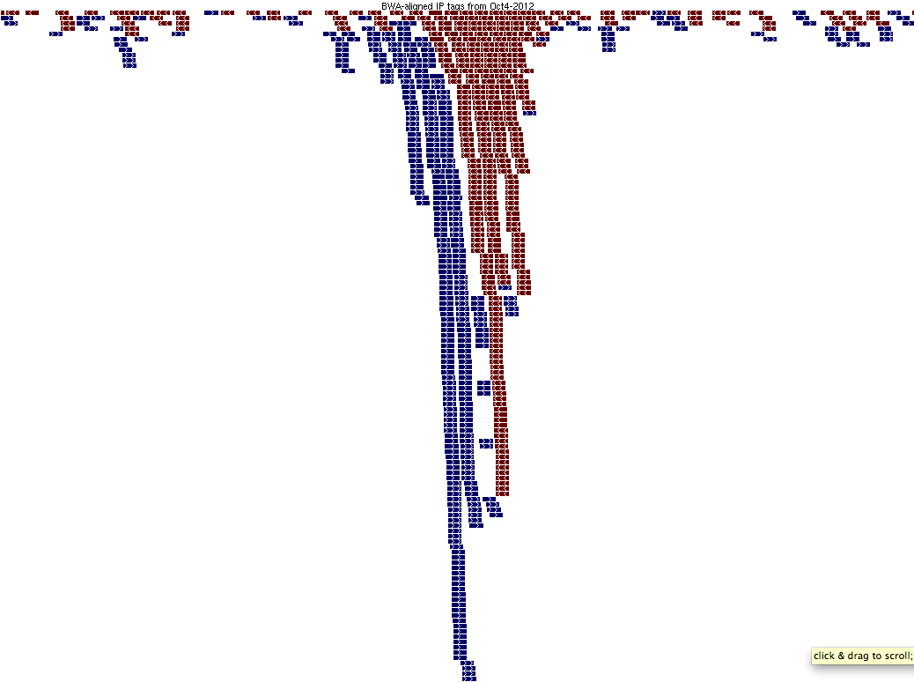
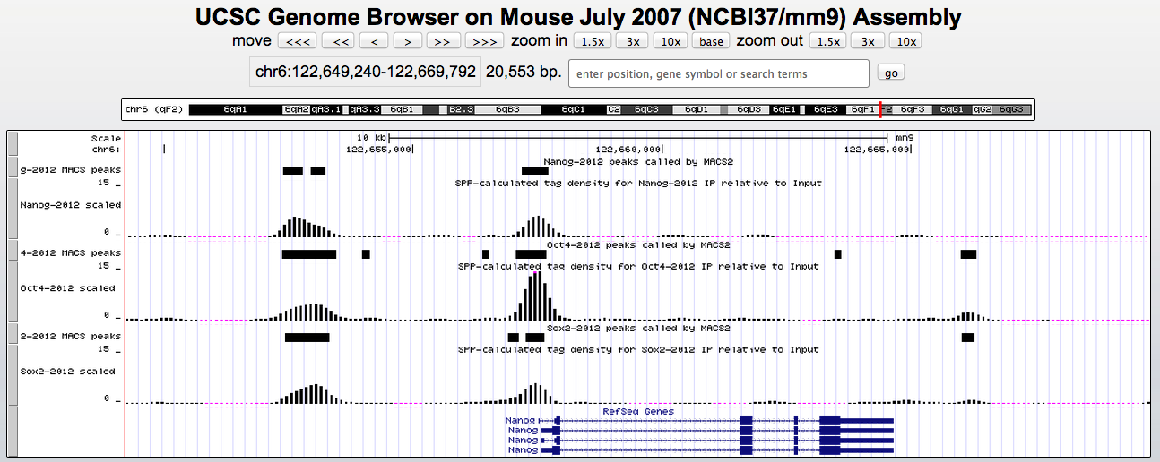
Input / Control
IP
ChIP-seq
Check Sequence Quality
Align to Reference Genome
Check ChIP-seq Signal
Find Peaks
and
Study Genomic Context

Slide 65
buildPipelineScripts.pl (-t chipseq)
Raw Sequencing Data
runBcl2fastq
- de-multiplex samples - generate fastq files
Fastq files
runAlign
- trim Fastq sequences
- Check FastQ Quality
- Align with Bowtie
- Build tracks for Genome Browser
BAM files
runPeakCaller
- call Peaks with SICER or MACS
- Build peak tracks for Genome Browser
- Annotate Peaks with nearest Genes
runDiffPeaks
- Not fully implemented yet
- Find differentially bound peaks, analyze

Slide 66
ssh tempuser01@quest.it.northwestern.edu
cd /projects/w10001/
# Make a directory for your analysis.
mkdir /projects/w10001/${USER}
# Change to the directory you just made.
cd /projects/w10001/${USER}
# Build the pipeline scripts in that directory.
/projects/p20742/tools/buildPipelineScripts.pl \
-t chipseq \
-o /projects/w10001/${USER} \
-account w10001 \
-g sacCer3 \
-f /projects/w10001/testChIP.fastq \
-chip /projects/w10001/testChIP.fastq/chipseqDesc.GSE53241.csv \
-uploadASHtracks 0 \
-runAlign 1 \
-runPeakCaller 1 \
>& buildPipelineScripts.chip.${USER}.log &
# Change back to original directory.
cd /projects/w10001/

Slide 67
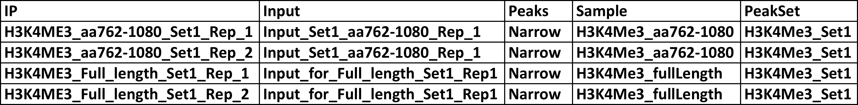
/projects/p20742/tools/buildPipelineScripts.pl \
-t chipseq \
-o /projects/w10001/${USER} \
-account w10001 \
-g sacCer3 \
-f /projects/w10001/testChIP.fastq \
-chip /projects/w10001/testChIP.fastq/chipseqDesc.GSE53241.csv \
-uploadASHtracks 0 \
-runAlign 1 \
-runPeakCaller 1 \
>& buildPipelineScripts.chip.${USER}.log &
Content of ChIP-seq Description File:

